Slide 1
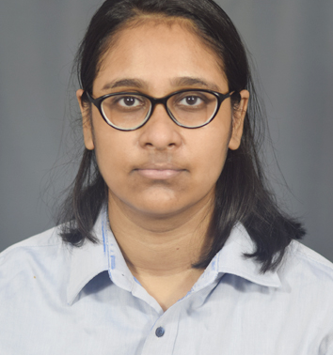


NEHA BHATTACHARYA
Bachelor of Technology
Electronics and Communication Engineering : 2018 - 2022
Analyst/Software Engineer
Skills
BANGALORE
Java 8 /J2EE | Java Basics, OOPS, Generics, Collections, Arrays, Loops, Lambda Exp, Stream API Junit, Mockito, Servlets
Spring core | IOC & Dependency Injection, Autowire
Spring REST | REST controllers, Implementation of GET, POST, PUT & DELETE, Bean Validation & Exception Handling, Testing Services, Controller & Repository layer
Spring Data JPA | Implement DAO layer using spring Data repositories, Transaction Management
Spring Boot Microservices | Spring Boot Starters, annotations, Messaging Service, Swagger API specifications
Spring Cloud | Eureka, Netflix Hystrix, Zuul & Config Server, Rabbit MQ
React | Components, Hooks, Event handling, Redux, Reducers, Testing using Jasmin & Karma
Database | MongoDB Atlas Basics PostgreSQL Basics
UI Tech | HTML 5 & CSS 3,JavaScript, ES6
Tools | Git, Postman, IDE,PMD,Checkstyle, solarLint
Add On skills | Communications, Team management. Peer learning
neha.b.bhattacharya@capgemini.com
+91 9064911563
A4
Hands on experience in creating Microservices with Spring Boot, Spring Security, Spring Cloud API Gateway, Eureka server, load balancing, Swagger, RabbitMQ.
Experience in TDD based development using Junit, Mockito including code quality compliance using Sonar Lint
Proficient in creating Single page Web Application in React with Authentication with routes, react bootstrap, Material UI , Axios. Proficient React developer with working knowledge on ReactJS.
Hands on experience in implementing polyglot architecture with spring boot.
Hands on experience in implementing MongoDB Atlas & PostgreSQL.
On Demand Car Wash Booking Application
Completed end to end case development of Car Wash Booking Application in JAVA Spring boot along with JWT authentication, Swagger, Spring Cloud, API Gateway, RabbitMQ and payment gateway using Paytm. React Js is used as the front-end interface. Bootstrap 5 and Material UI is used for extra styling apart from CSS. MongoDB is used as the Database in the whole application.
Bus Booking Application
Completed end to end development of Bus Booking System in Java Spring Boot. React Js is used as the front-end interface. Bootstrap 5 is used for extra styling apart from CSS. H2 Database and PostgreSQL is used as the database in the whole application.
Check out my work on GitHub

